Slide 1
Plug The Power
www.hgdindia.com

Slide 2

CONTENTS
01
Brief Introduction
06 Product Series
02 Background History
07
Management Chart
03 Production Capabilities
08
Vision & Assurance
04 Quality Check
09
Customer List
05
Real Scene
10
Contact Details
www.hgdindia.com

Slide 3

BRIEF INTRODUCTION
INDIA’S LARGEST MOBILE
PHONE CHARGER MANUFACTURER
“ THE QUALITY YOU CAN TRUST”
Hong Guang De Technology India Pvt. Ltd.(HGD India) is joint venture of Shenzhen Hong Guang De Technology Co Ltd. (HGD China). Hong Guang De Technology India Pvt. Ltd. is the leading mobile charger manufacturing unit in India.
It is a professional mobile phone charger manufacturer specialized in development, manufacturing, sales and service. We have a trained and qualified engineers as well as Staffs , who are capable enough to achieve their targets. The vision of our company is practical, delicate, high quality and value for money products.
Leading to MAKE IN INDIA, concept started by our Honourable Prime minister Mr. Narendra Modi, in the light of this ideas. The company now has more than 500 employees in India , and still counting.
www.hgdindia.com

Slide 4






PRESENCE
HGD China - Shenzhen
Charger Assembling / SMT
HGD China – Shenzhen
Plastics Moulding
CHINA
INDIA
HGD India- Noida
Charger Assembling / SMT
HGD India - Sampla
Plastics Moulding
HGD China – JiangXi DaYu
Charger Assembling
www.hgdindia.com

Slide 5
HISTORY
HGD CHINA FOUNDED
Shenzhen Hong Guang De Technology Co LTD. (HGD China).
2009
FACTORY CERTIFICATION
HGD China Factory got ISO 9001 & Obtained CE Certification & RoHS Certification
NEW SETUP STARTED
2010
HGD China setup departments of Injection molding, Cable, Power supply and SMT.
GOT UL CERTIFICATE
HGD China Passed the UL test, and got UL
2012
HGD CHINA & HGD INDIA
HGD India & HGD China started Joint
Venture & Start Production
certificate
2015
HGD PRODUCTION BOOST
HGD China double their production 6 million /
month.
HGD India Increase Capacity up to 2.5 Million/ month Established.
HGD INDIA CERTIFICATION
HGD India got ISO 9001 - 2015 certification
2016
HGD India got BIS of more than 52 models.
www.hgdindia.com

Slide 6
NEW SETUP IN INDIA
Started Injection Molding.
2017
NEW SETUP IN CHINA
HONOR WIDE new establishment started at China.
R&D READY
Started our own SMT lines & R&D Ready
2018
NEW PRODUCT LINE
Setup box Assembly
2019
NEW PRODUCT LINE
3.1 Amp QC /USB Wall Sockets
/CCTV/Router adaptor’s
2020
www.hgdindia.com

Slide 7
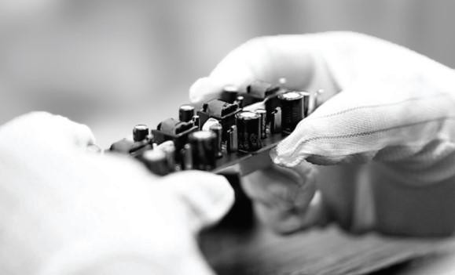
PROSPECT
PRODUCTION CAPACITIES
2 MILLION CHARGERS
We have capacity of more than 2 million chargers every month.
4000 TON RAW MATERIAL
We have 4000 ton Raw Material always available in our stock.
60,000 SQ. FT AREA
Manufacturing Unit is in 60,000 sq. ft. Area for manufacturing.
10,000 SQ. FG AREA
We have 10,000 sq. ft. FG Area (Finished Goods).
INDIA’S LARGEST MOBILE
PHONE CHARGER MANUFACTURER
16 ASSEMBLY LINES
We offer 16 Assembly Lines to meet the high demand products
“ THE QUALITY YOU CAN TRUST”
www.hgdindia.com

Slide 8







PROSPECT
YEAR 2020 - 2022
PRODUCTION 2020
Phone Charger 2 M / Month STB 50K/ Month
(16) Lines
EXPANSION PLAN-2022
Phone Charger 4 M/ Month
STB150K
Power Adaptor 1 M/ Month
(20) Lines
MANPOWER- 2020
500 Manpower
EXPANSION PLAN- 2021
Phone Charger 3 M / Month STB 100K
Power Adaptor 400K
(18) Lines
MANPOWER 2020
300 Manpower
MANPOWER- 2022….
1000 Manpower
www.hgdindia.com

Slide 9
06
QUALITY CHECK
OQC TEST
₀₅ FUNCTION TEST
04
HI POT TEST
03
BURN TEST
02
PQC TEST
01
IQC TEST
www.hgdindia.com

Slide 10
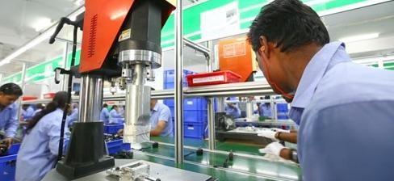
REAL SCENE
16 ASSEMBLY LINES
Manufacturing & Delivery of 5 Million Mobile Charger per month.
www.hgdindia.com

Slide 11
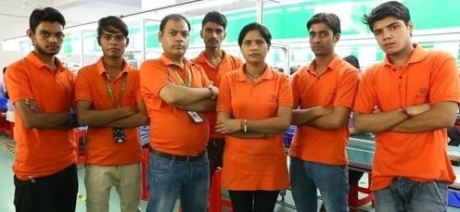
REAL SCENE
300+ MANPOWER
Team of highly experienced engineers, Well Equipped & experienced R&D Department.
www.hgdindia.com

Slide 12
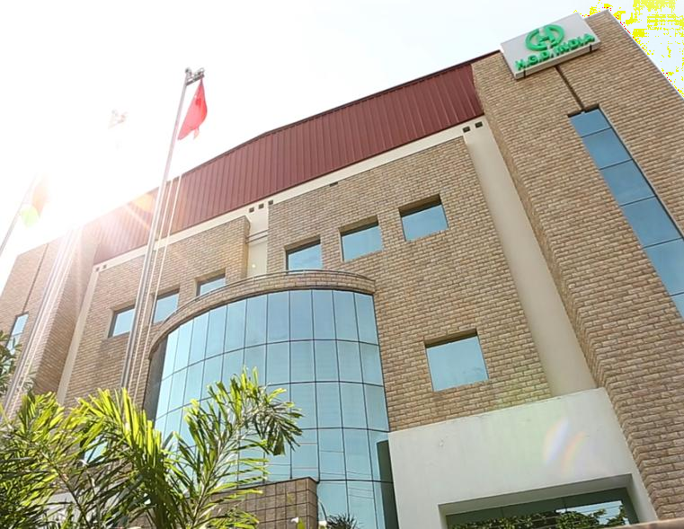
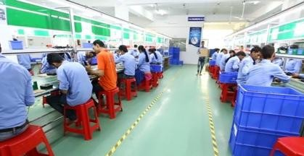
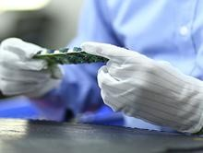
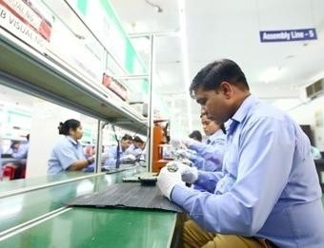
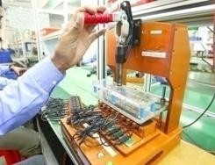
REAL SCENE
FACTORY TOUR (HGD India)
Professional Manufacturer of Mobile Chargers
www.hgdindia.com

Slide 13
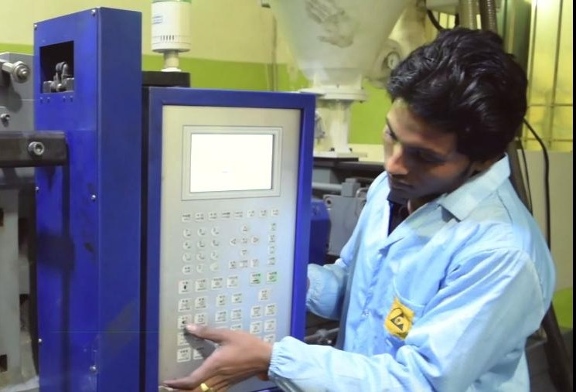
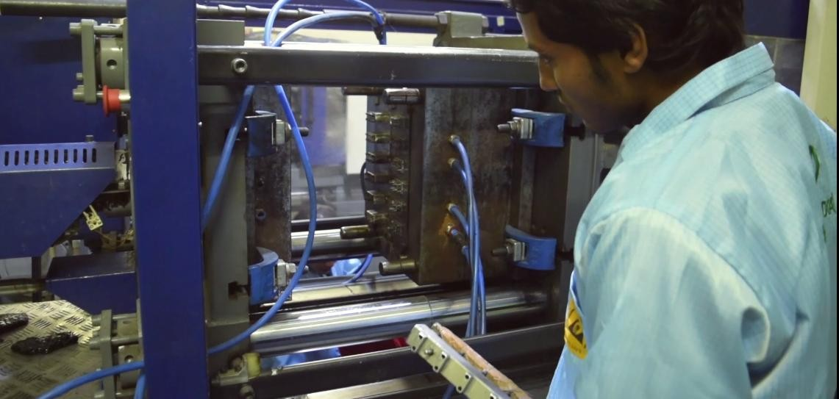
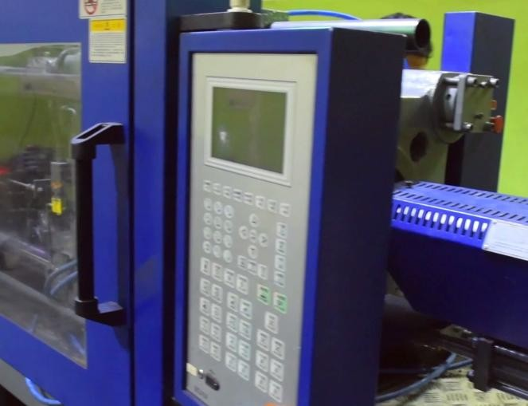
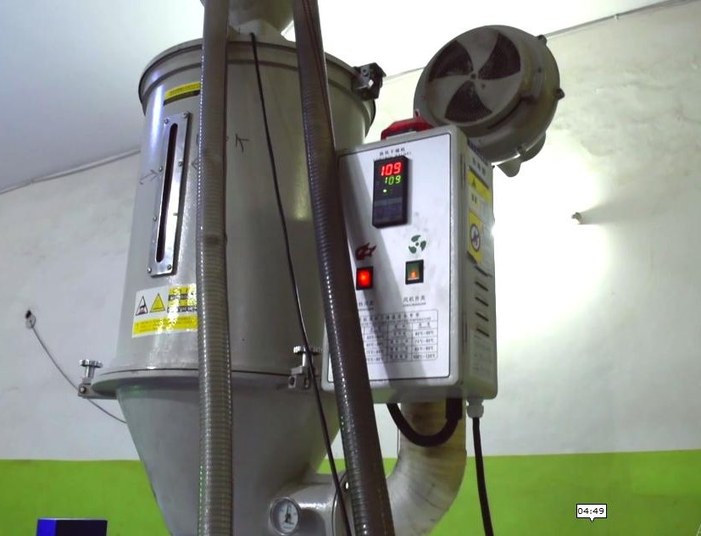
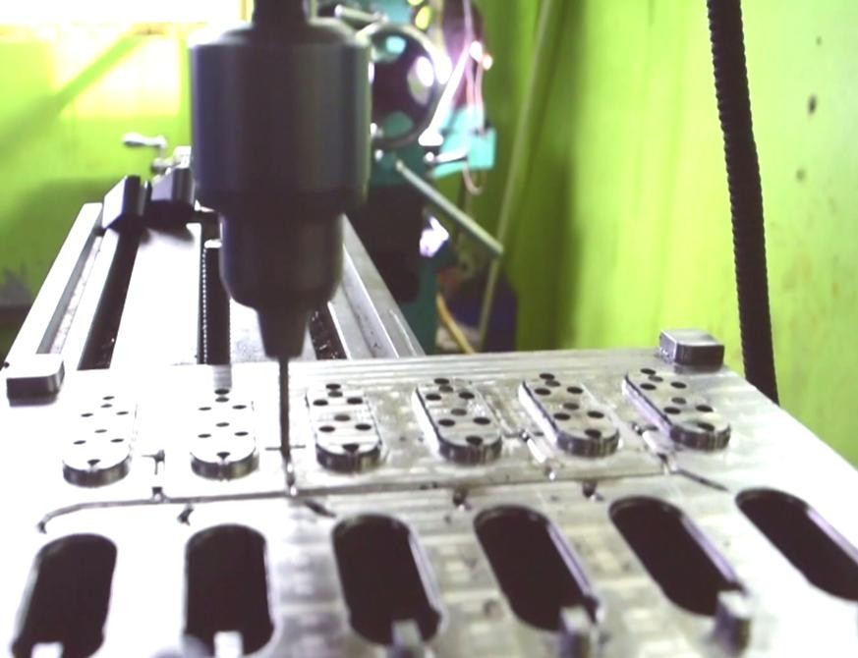
REAL SCENE
FACTORY TOUR (HGD Plastics)
Professional Manufacturer of Mobile Chargers
www.hgdindia.com

Slide 14
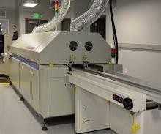
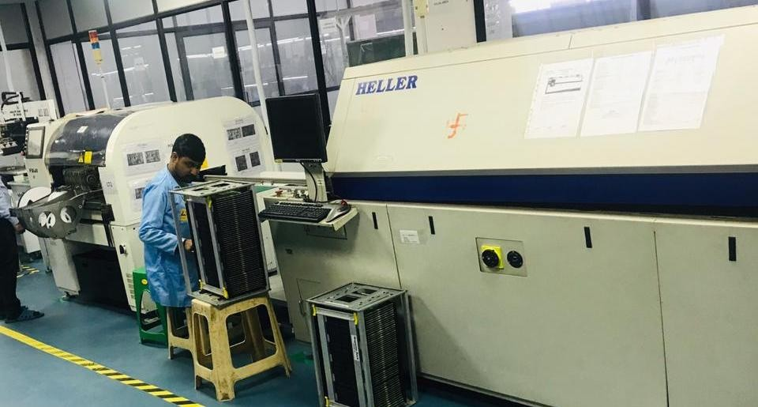
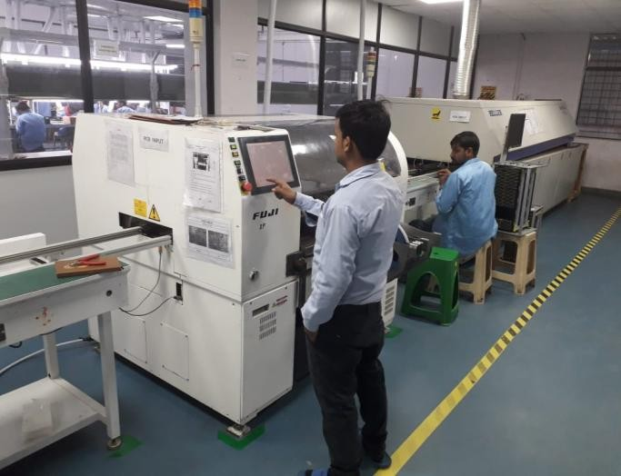
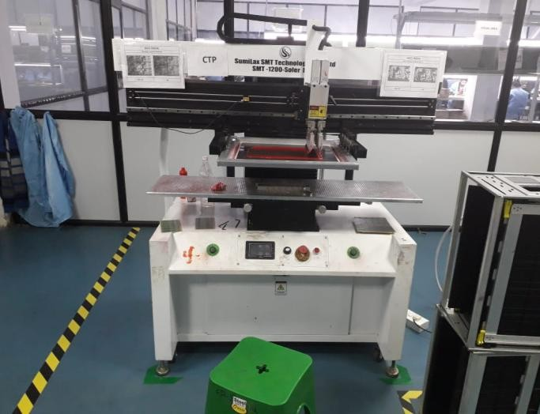
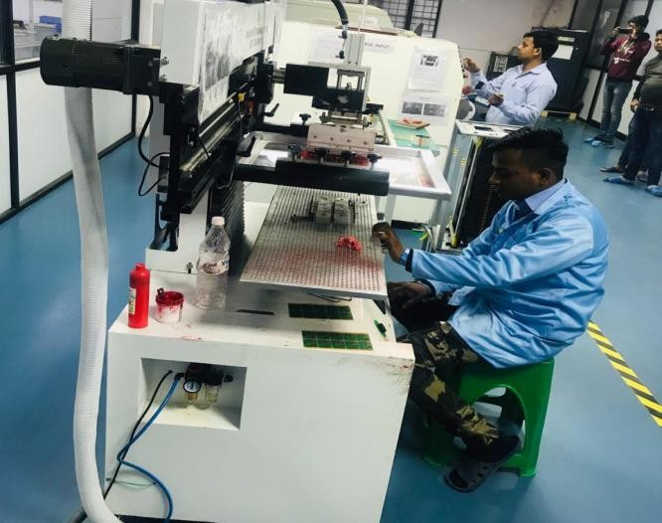
REAL SCENE
FACTORY TOUR (HGD SMT )
Professional Manufacturer of Mobile Chargers
www.hgdindia.com

Slide 15
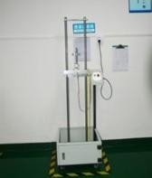
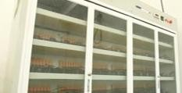
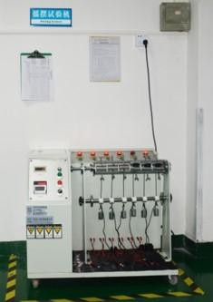
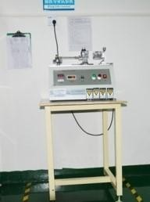
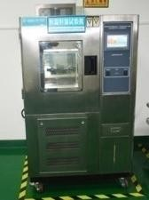
REAL SCENE
FACTORY TOUR (HGD Quality)
Professional Manufacturer of Mobile Chargers
www.hgdindia.com

Slide 16
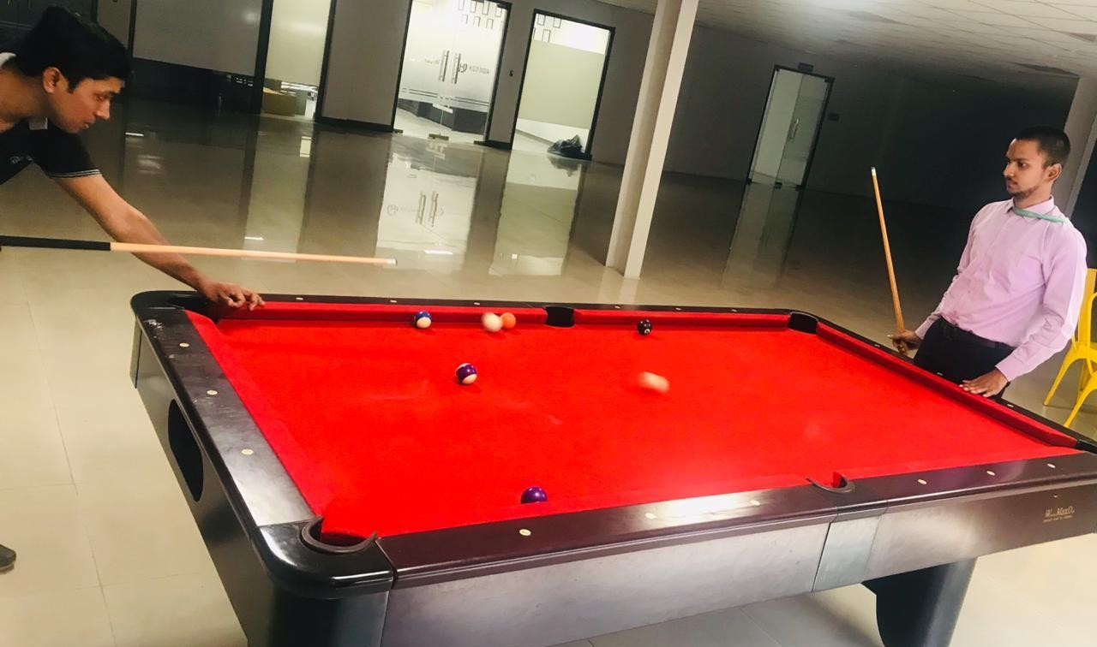
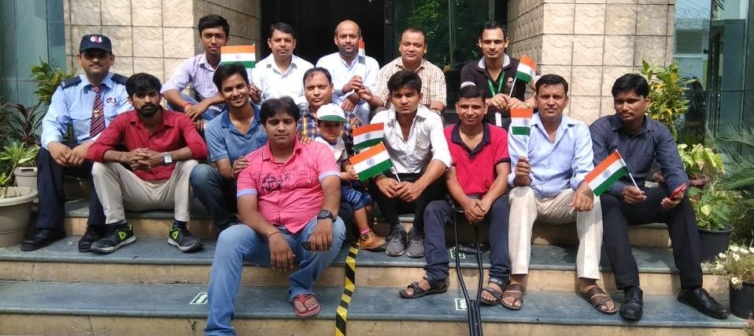
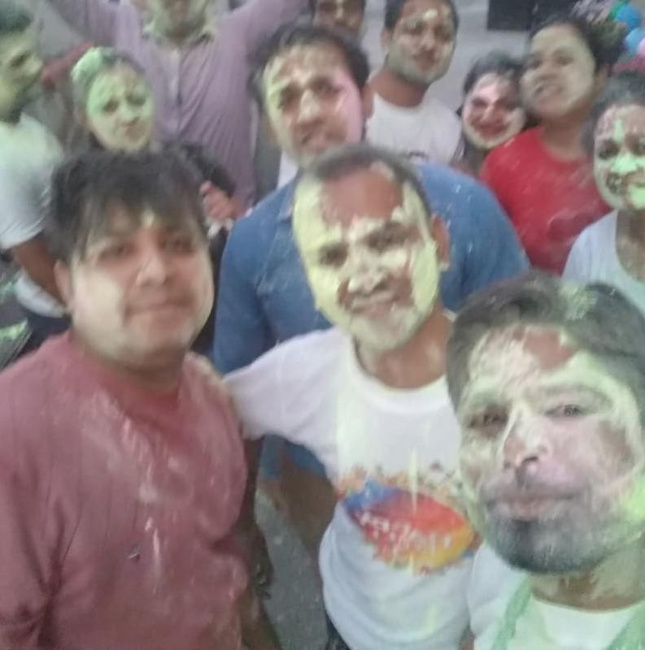
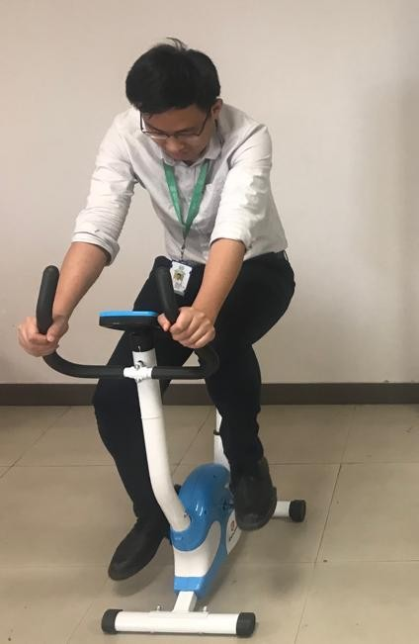
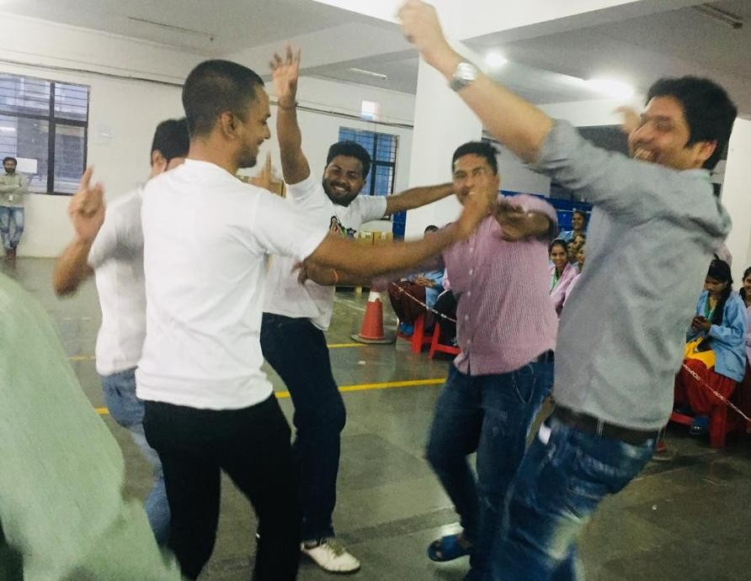
REAL SCENE
:
FACTORY TOUR (HGD Happy Moments)
Professional Manufacturer of Mobile Chargers
www.hgdindia.com

Slide 17
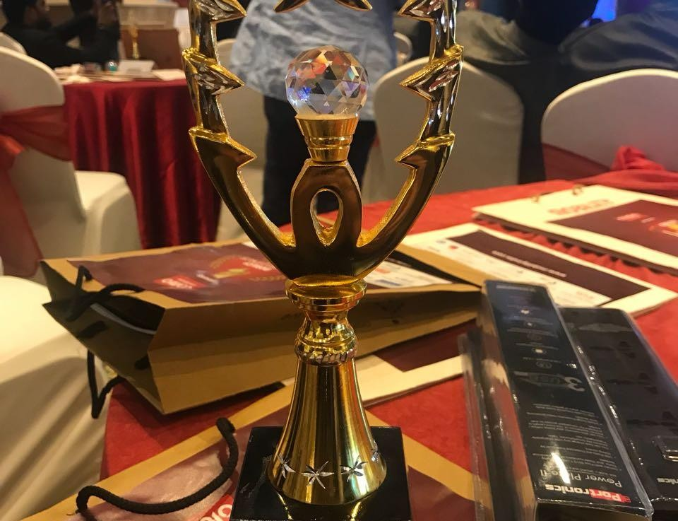
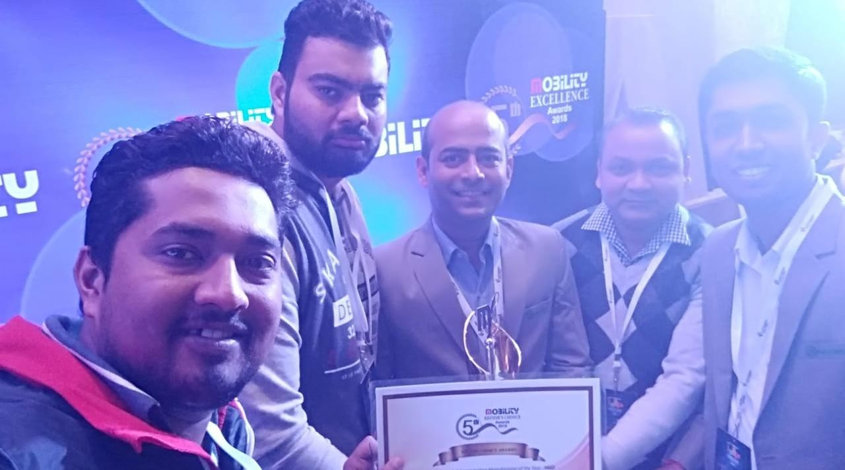
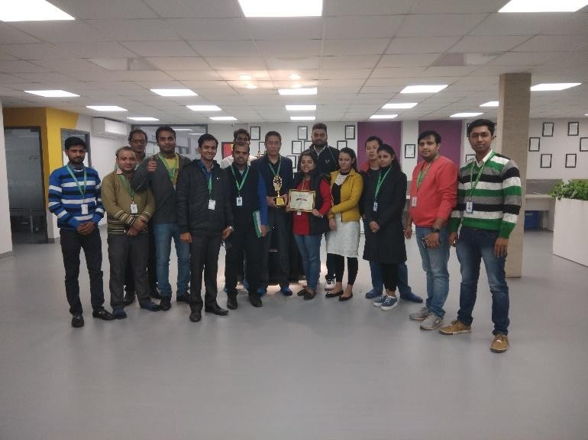
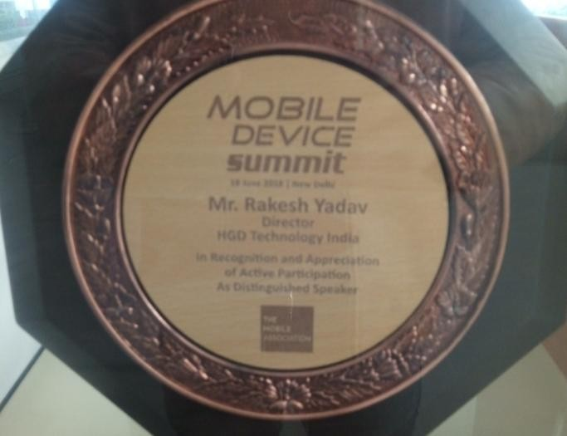
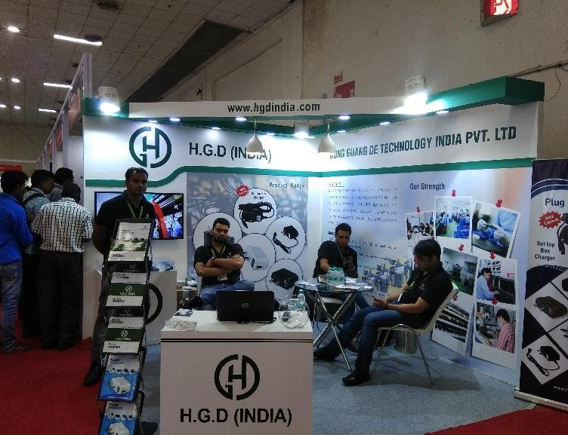
REAL SCENE
HGD AWARDS (HGD recognitions)
Professional Manufacturer of Mobile Chargers
www.hgdindia.com

Slide 18
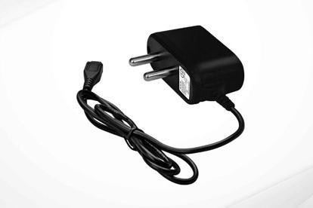
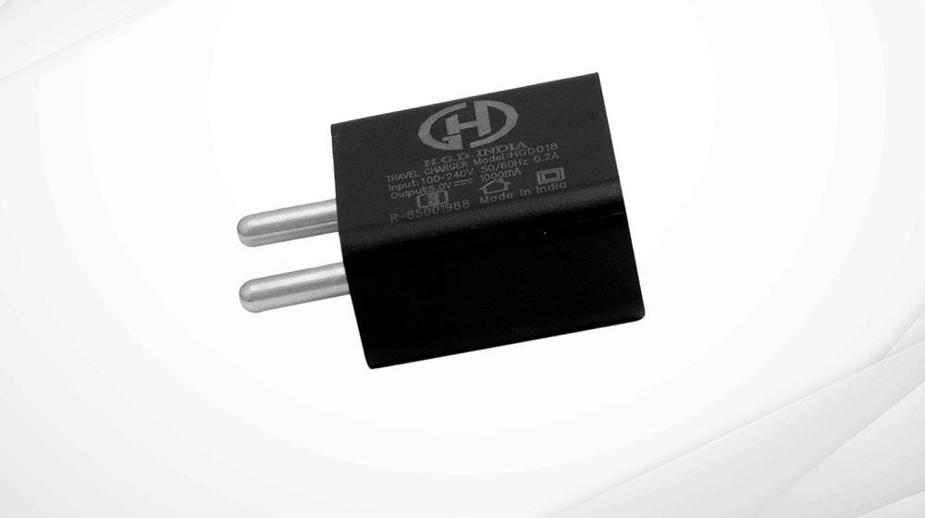



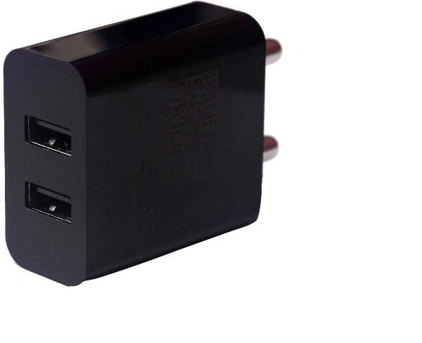
PRODUCT SERIES (Travel Chargers)
0.5 AMP WIRED CHARGER
0.7 AMP WIRED CHARGER
1 AMP USB CHARGER
1 AMP USB CHARGER
2 AMP USB CHARGER (White)
2 .4 AMP Dual USB Adaptor
www.hgdindia.com

Slide 19
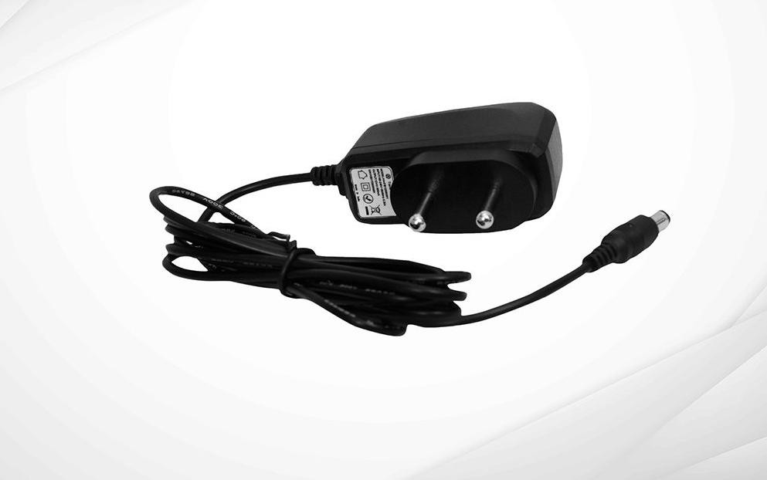
PRODUCT SERIES (STB Adapters)
9V Adaptor
12V Adaptor
www.hgdindia.com

Slide 20

PRODUCT SERIES (STB EMS)
Set Top Box
www.hgdindia.com

Slide 21
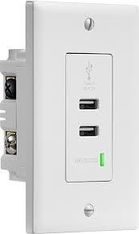
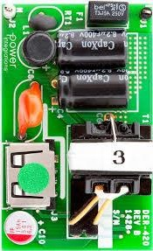
PRODUCT SERIES (USB Wall Socket)
USB Wall Socket
www.hgdindia.com

Slide 22



PRODUCT SERIES (Infrared Medical Thermometer)
Medical Thermometer
www.hgdindia.com

Slide 23






MANAGEMENT CHART
Director
QUALITY
INCOMING INSPECTION
PROCESS INSPECTION
OUTGOING INSPECTION
CUSTOMER SERVICE
PRODUCTION
FLOOR MANAGER
TEAM LEADER
OPERATOR
SALES
SALES MANAGEMENT
BRAND MANAGEMENT
SUPPLY CHAIN
 | WAREHOUSE MANAGEMENT
 | PLANNING (PMC)
 | PURCHASE
ADMINISTRATION & PERSONAL
ENGINEERING DEPARTMENT
FINANCE
HR EXECUTIVE
R & D TEAM
CASHIER
ENGINERRING TECHNICIAN
ACCOUNTANT
www.hgdindia.com

Slide 24



VISION & ASSURANCE
VISION
To build an
acrobatic
and passionate
Innovation,
organization in Performance and
which
Productivity are
the
priority to make HGD India,
a leading
charger manufacturer in India.
CAPABILITIES
ASSURANCE
Our assurance is to provide best solution to our customers as per their requirement with best competitive price and prompt deliveries with all quality checks.
PROMPT DELIVERIES
www.hgdindia.com

Slide 25











CUSTOMERS
LAVA
XOLO
MICROMAX
ITEL
FOXCONN
NOKIA
FLEX
RELINCE JIO
INFOCUS
FRONTECH
PORTRONICS
BALAJI SOLUTION
Adding more….
www.hgdindia.com

Slide 26

CONTACT US
HONG GUANG DE TECHNOLOGY INDIA PVT. LTD.
Contact - 999 997 3612/ 9958518464
info@hgdindia.com
www.hgdindia.com

Slide 27
THANK YOU FOR LISTENING!
Looking for your Business Cooperation
Facebook
Facebook.com/ hgdindia
www.hgdindia.com

